Slide 1


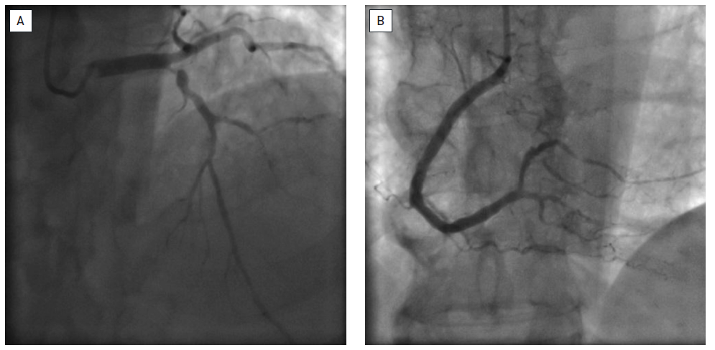

Interventions for patients with diabetes mellitus
Figure 1
Multivessel coronary artery disease in a diabetic patientThe angiographies evidence an affected left anterior descending artery with severe proximal stenosis with diffuse distal disease (A), as well as, diffuse distal disease in the right coronary artery (B).
Manel Sabaté
©2025 Europa Group - All rights reserved.

