Slide 1


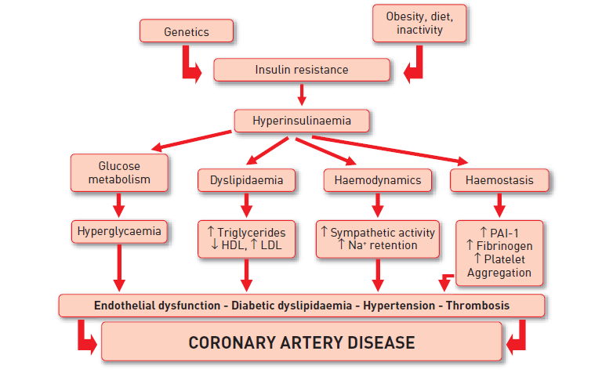

Interventions for patients with diabetes mellitus
Figure 2
Role of insulin resistance on the features of type 2 diabetic patientsIn type 2 diabetes mellitus, insulin resistance induces through different mechanisms hyperglycemia, diabetic dyslipidemia, fluid retention, endothelial dysfunction and a prothrombotic milieu, altogether leading to coronary artery disease.PAI: Plasminogen Activator Inhibitor-1.
Manel Sabaté
©2025 Europa Group - All rights reserved.

