Slide 1


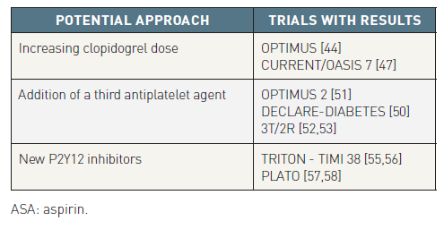

Interventions for patients with diabetes mellitus
Table 1
Potential approaches to treat ASA and clopidogrel resistance
Manel Sabaté
©2025 Europa Group - All rights reserved.

