Slide 1


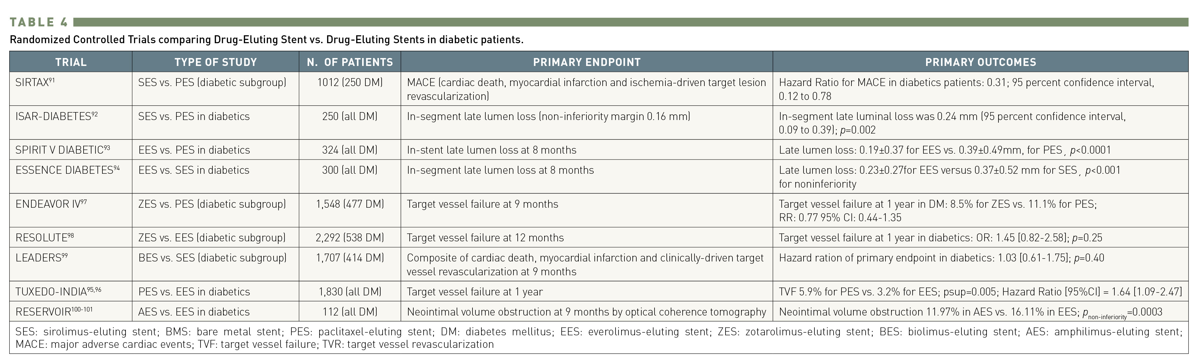
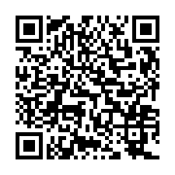
Interventions for patients with diabetes mellitus
Table 4
Randomized Controlled Trials comparing Drug-Eluting Stent vs. Drug-Eluting Stents in diabetic patients.
Manel Sabaté
©2025 Europa Group - All rights reserved.

