Slide 1


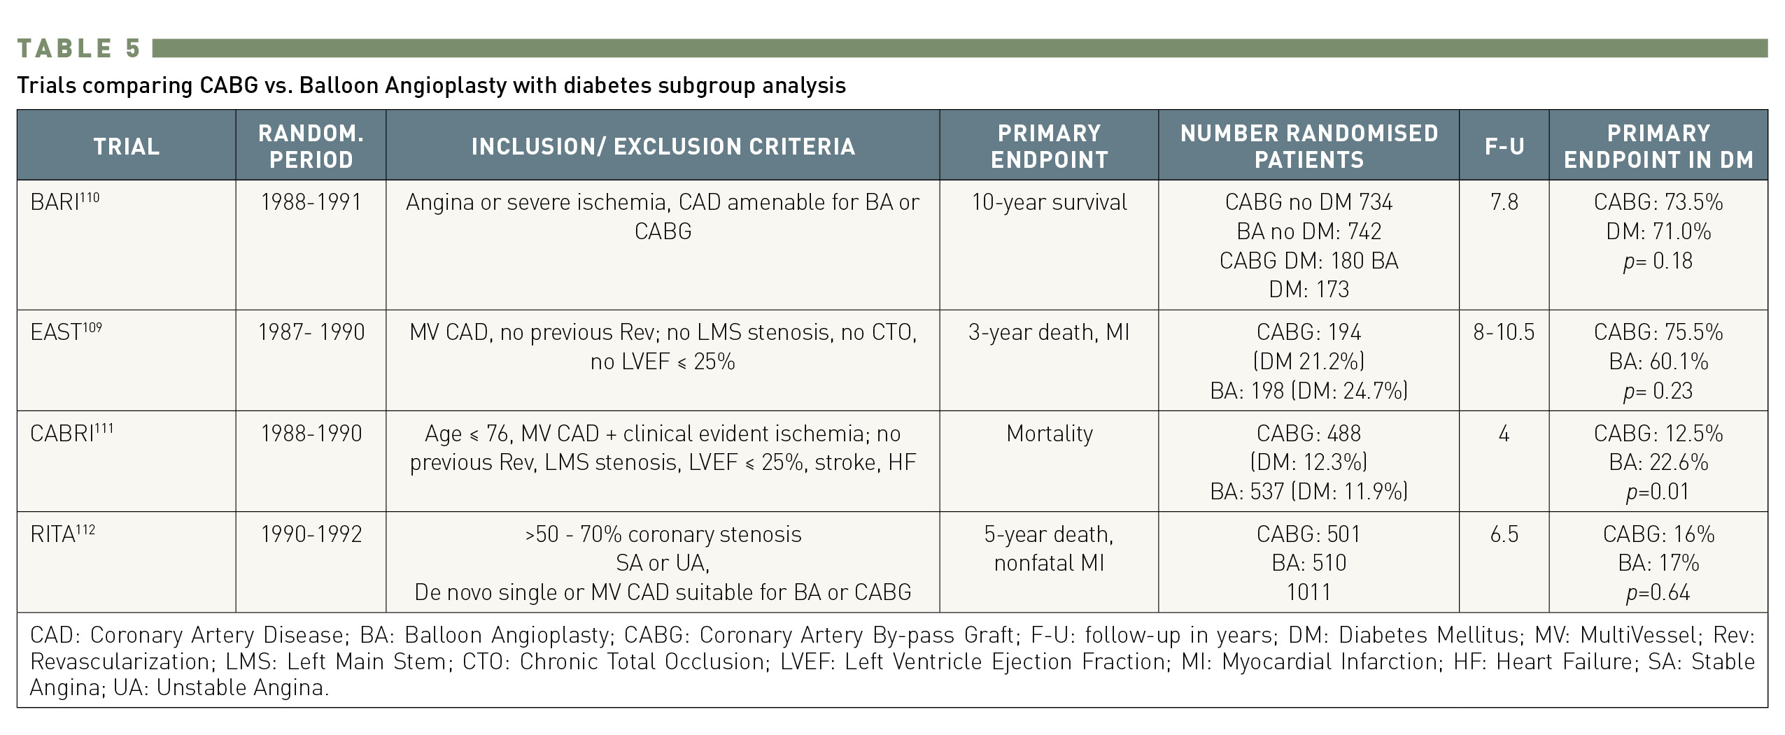

Interventions for patients with diabetes mellitus
Table 5
Trials comparing CABG vs. balloon angioplasty with diabetes subgroup analysis
Manel Sabaté
©2025 Europa Group - All rights reserved.

