Slide 1


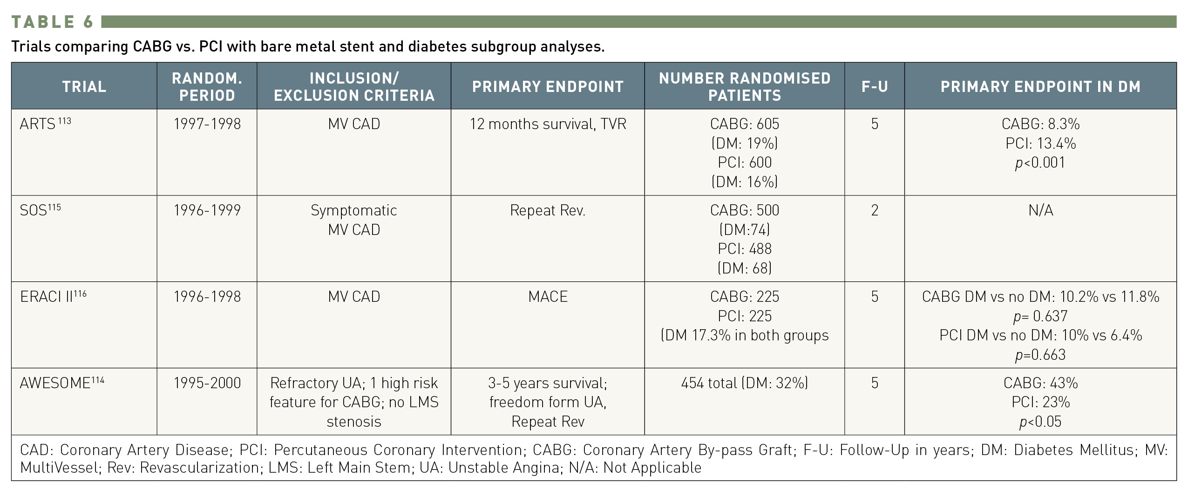

Interventions for patients with diabetes mellitus
Table 6
Trials comparing CABG vs. PCI with bare metal stent and diabetes subgroup analyses
Manel Sabaté
©2025 Europa Group - All rights reserved.

