Slide 1


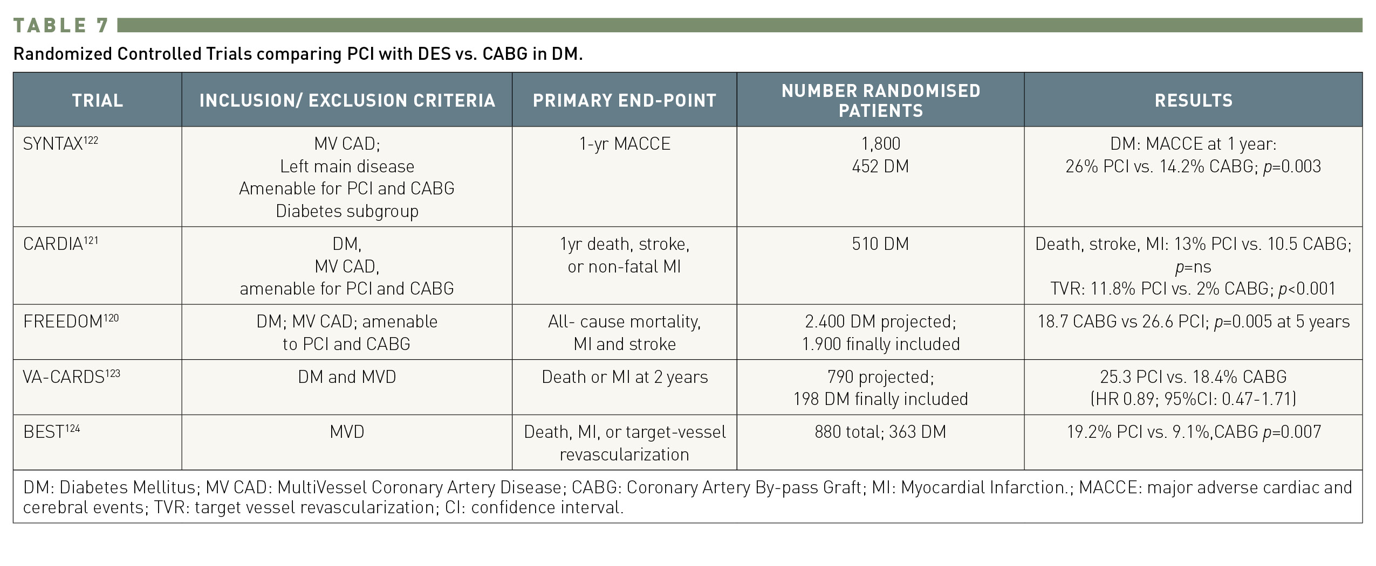

Interventions for patients with diabetes mellitus
Table 7
Randomized controlled trials comparing PCI with DES vs. CABG in DM.
Manel Sabaté
©2025 Europa Group - All rights reserved.

