Slide 1


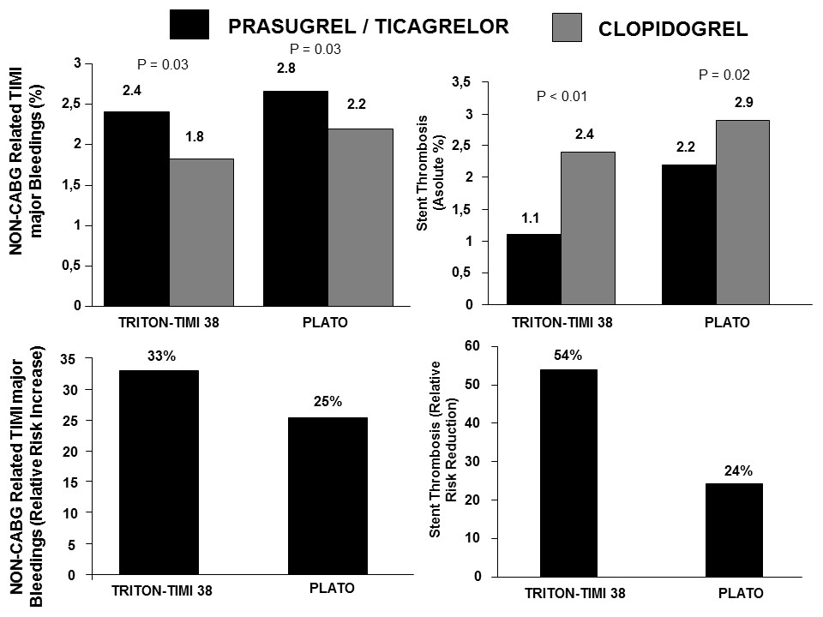
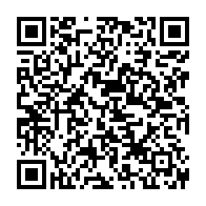
Interventions for ST-segment elevation acute myocardial infarction
Figure 10
< 75 y No previous strokeWeight > 60 kg
Dariusz Dudek, Carlo Di Mario, Giuseppe De Luca, Artur Dziewierz, Tomasz Rakowski
©2025 Europa Group - All rights reserved.

