Slide 1


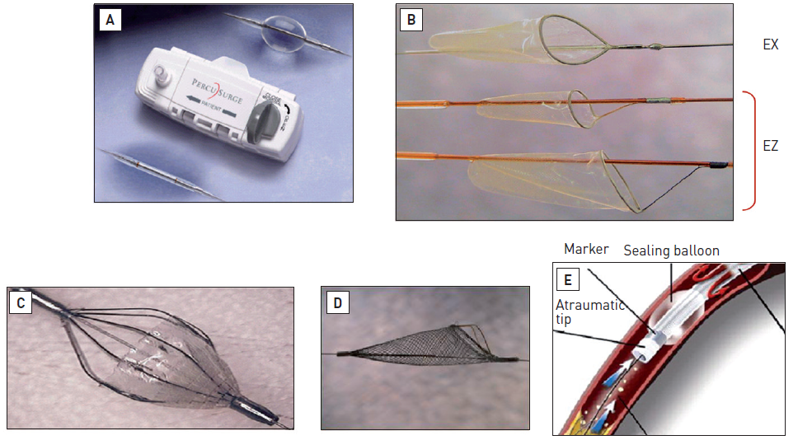

Interventions for ST-segment elevation acute myocardial infarction
Figure 5
Protection devices(A) PercuSurge GuardWire™ temporary occlusion and aspiration system consists of a 0.014" guidewire with a distal occlusive balloon (upper right corner) which is inflated distally to the stenosis by the EZ Flator® (middle) in order to block antegrade flow. At the end of the intervention, all the debris is aspirated by a 5 Fr monorail catheter (Export) (lower left corner). (B) FilterWire EZ is a non-occlusive, filter-based distal protection device. It consists of a polyurethane porous membrane filter (pore size 110 micron), attached to a nitinol loop which adapts to the vessel wall at the distal end of a 0.014" guidewire. In the most recent version (EZ) the loop is attached to an anchor which helps in case of vessel tortuosity. Delivery and retrieval of the filter are performed through the use of a dedicated sheath. The device can be used in vessels with a diameter ranging between 3.5 and 5.5 mm. (C) The AngioGuard® distal protection device consists of a filter integrated into a 0.014" stainless steel angioplasty wire. The filter has a nickel-titanium skeleton supporting a polyurethane membrane creating a collection basket. The membrane has multiple laser-drilled pores of 100 μm. The basket diameters vary from 4.0 to 8.0 mm and are designed for use in 3.0 to 7.5 mm. The device is held closed by an outer delivery sheath. The AngioGuard® requires a 7 Fr catheter, and is deployed after crossing the target lesion by pulling back the delivery sheath. A second sheath is used to close and remove the filter. (D) The SpideRX® Embolic Protection Device is 6 Fr guiding catheter compatible. It features a pre-loaded nitinol filter (multiple sizes ranging from 3.0 to 7.0 mm) with a dual-ended catheter for delivery and recovery, mounted on a 0.014" guidewire. (E) Proxis™ is a proximal embolic protection system with a single working lumen, a vessel-sealing balloon and a soft atraumatic tip. The Proxis™ catheter comprises a soft Pebax® tip with a radius on the outer edge to minimise tissue injury, a radiopaque marker band for visibility, and a low-pressure urethane sealing balloon. The catheter itself is a wound stainless steel coil coated in Pebax®. The entire shaft and balloon are hydrophilically coated.
Dariusz Dudek, Carlo Di Mario, Giuseppe De Luca, Artur Dziewierz, Tomasz Rakowski
©2025 Europa Group - All rights reserved.

