Slide 1


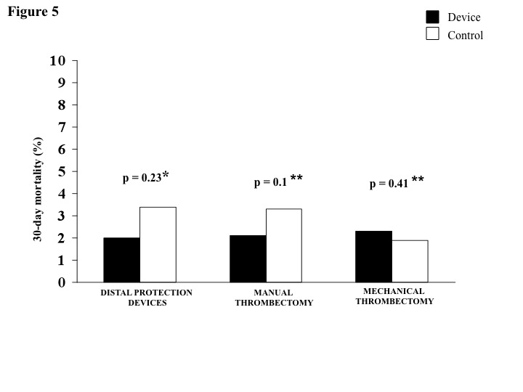

Interventions for ST-segment elevation acute myocardial infarction
Figure 6
Adjunctive mechanical devices to prevent embolization in primary PCI: a meta-analysis of RCTs.Pooled data by random effect model (the DerSimonian and Laird method) of benefits from adjunctive distal protection (*) and thrombectomy devices (**) in 30-day mortality. (*) De Luca G et al. AHJ 2007; 153: 343-5; (**) De Luca G et al. Int J Cardiol 2013; 166: 606-12.
Dariusz Dudek, Carlo Di Mario, Giuseppe De Luca, Artur Dziewierz, Tomasz Rakowski
©2025 Europa Group - All rights reserved.

