Slide 1


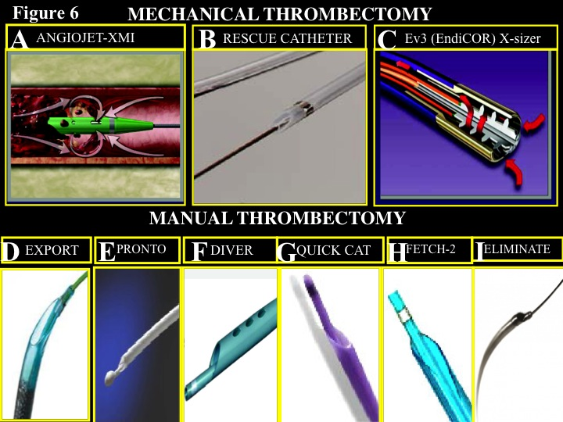

Figure 7
Thrombectomy devices.Mechanical (upper graphs) and manual (lower graphs) thrombectomy devices: A) The angiojet thrombectomy system is a 4F catheter connected to a driving unit, which generates high-velocity saline jets at the distal end of the catheter. The resulting wortex fragments and aspirates thrombus material by Venturi effects (rheolytic thrombectomy) in a collecting lumen. B) The X-Sizer catheter, compatible with a 7 French guiding catheter, promotes mechanical thrombectomy by an elicoidal cutter positioned at the end of the catheter. By advancing the catheter, the elicoidal cutter fragments the thrombus that is in the meanwhile aspirated by the means of continuous negative pressure maintained by the system. C) The Rescue catheter (Boston Scientific/Scimed, Inc, Maple Grove, Minn) is a thrombectomy system made up of a 4.5F polyethylene catheter to be advanced over a guidewire through a 7F guiding catheter. The proximal end of the catheter has an extension tube connected to a vacuum pump (0.8 bar) with a collection bottle. D) The Diver catheter is a rapid-exchange, 6F compatible, thrombus-aspirating catheter. It has a central aspiration lumen and a soft, flexible non traumatic tip with multiple holes. A 30-ml luer-lock syringe is connected to the proximal hub of the central lumen for thrombus aspiration. E) The Pronto catheter is a rapid-exchange, 6F compatible, thrombus-aspirating catheter. It has a soft, flexible non traumatic tip, and a sloped extraction lumen opening to protect arterial wall during extraction. A 30 ml luer-lock syringe is connected to the proximal hub of the central lumen for thrombus aspiration. F) The Export AP aspiration catheter is a rapid-exchange, 6F compatible, thrombus-aspirating catheter. It has a soft, flexible non traumatic tip, with an oblique aspiration tip design. There is a main (continuous) lumen (the aspiration/infusion lumen) and a smaller lumen for the guidewire. A luer-lock syringe is connected to the proximal hub of the main lumen for thrombus aspiration. The Full-Wall Variable Braiding Technology used in the Export® AP Catheter significantly reduces the incidence of kinks and improves overall deliverability, even in the most challenging cases. G) The Quick cat is a rapid-exchange, 6F compatible, thrombus-aspirating catheter. There is a main (continuous) lumen (the aspiration/infusion lumen) and a smaller lumen for the guidewire. A luer-lock syringe is connected to the proximal hub of the main lumen for thrombus aspiration. It has good pushability, due to flexible and kink-resistant Pebax distal end complemented by a more stiff proximal end to traverse tortuous anatomy; the hydrophilically-coated distal end with a 4.5F crossing profile allows for ease of advancement; a consistent extraction lumen through the length of the catheter minimizes bottle-neckin. H) The Fetch-2 is a rapid-exchange, 6F compatible, thrombus-aspirating catheter. It has a central aspiration lumen and a soft, flexible non traumatic tip with multiple holes. A 30-ml luer-lock syringe is connected to the proximal hub of the central lumen for thrombus aspiration. It has a soft, flexible non traumatic tip, with an oblique aspiration tip design. Special features of this catheters are: variable pitch coiled shaft for improved kink resistance; low pitch distal shaft to promote flexibility; high pitch proximal shaft to enhance pushability; distal hydrophilic coating to promote deliverability; enhanced distal radiopaque marker band for improved visibility; positioning marker bands at 95cm and 105cm to minimize the need for fluoroscopy; white tip to facilitate guidewire loading. I) The Eliminate is a rapid-exchange, 6F compatible, thrombus-aspirating catheter. It has a central aspiration lumen and a soft, flexible non traumatic tip with multiple holes. A 30-ml luer-lock syringe is connected to the proximal hub of the central lumen for thrombus aspiration. Special features are: the pre-loaded stylet; fully braided shaft and 23 cm long rapid exchange segment for improved deliverability; large extraction lumen and rounded short tip design for enhanced aspiration capability; short and thin distal marker for ease of use.
Interventions for ST-segment elevation acute myocardial infarction
Dariusz Dudek, Carlo Di Mario, Giuseppe De Luca, Artur Dziewierz, Tomasz Rakowski
©2025 Europa Group - All rights reserved.

