Slide 1


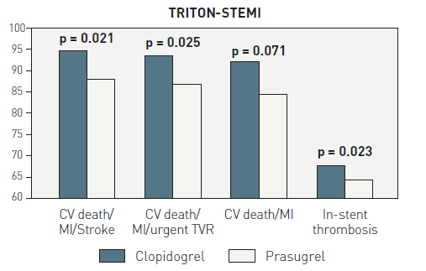
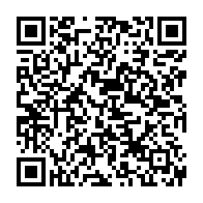
Interventions for ST-segment elevation acute myocardial infarction
Figure 8
TRITON-STEMIBar graphs show the beneficial effects in clinical outcome among STEMI patients undergoing angioplasty treated with prasugrel as compared to clopidogrel in the TRITON randomised trial.CV: cardiovascular; MI: myocardial infarction; TVR: target vessel revascularisation.
Dariusz Dudek, Carlo Di Mario, Giuseppe De Luca, Artur Dziewierz, Tomasz Rakowski
©2025 Europa Group - All rights reserved.

