Slide 1


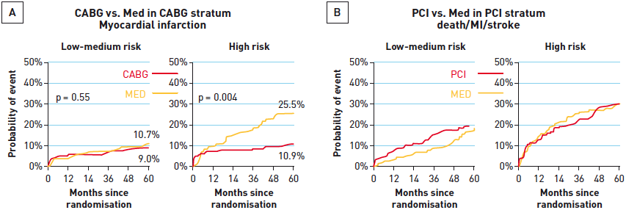

Interventions for stable coronary disease (chronic coronary syndromes)
Figure 10
Utility of revascularisation in diabetic patients(A) In the BARI 2-D study diabetic patients with stable CAD were risk stratified into low, intermediate, and high risk groups utilising the “angiographic score” (see text for details). Those patients with high angiographic scores, and therefore greater burden of disease, benefited from revascularisation with CABG with significant reductions in MACE (death, MI, or stroke) rates over a 5-year period compared to those treated with optimal medical therapy as an initial strategy. (B) Notably, revascularisation with PCI did not confer the same protection on diabetic patients with high angiographic scores compared to the group treated with OMT.[Adapted with permission from Nesto RW et al. American Heart Association Annual Scientific Sessions, November, 2010]
Pradyumna Tummala, Bill D. Gogas, Patrick Bastos Metzger, David Williams, J. Ribamar Costa Jr, Raffaele piccolo
©2025 Europa Group - All rights reserved.

