Slide 1


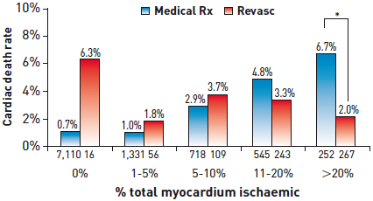

Interventions for stable coronary disease (chronic coronary syndromes)
Figure 11
Ischaemic burden and revascularisationPatients who underwent stress testing with stable CAD and no history of MI or prior revascularisation were followed for a mean of approximately 2 years. There was a significant improvement in cardiac death rate if patients underwent revascularisation compared to medical therapy alone, but only in the group which had ischaemia involving >10% of the left ventricle by SPECT imaging.[Adapted with permission from Hatchamovitch R et al. Circulation. 2003;107:2900-06]
Pradyumna Tummala, Bill D. Gogas, Patrick Bastos Metzger, David Williams, J. Ribamar Costa Jr, Raffaele piccolo
©2025 Europa Group - All rights reserved.

