Slide 1


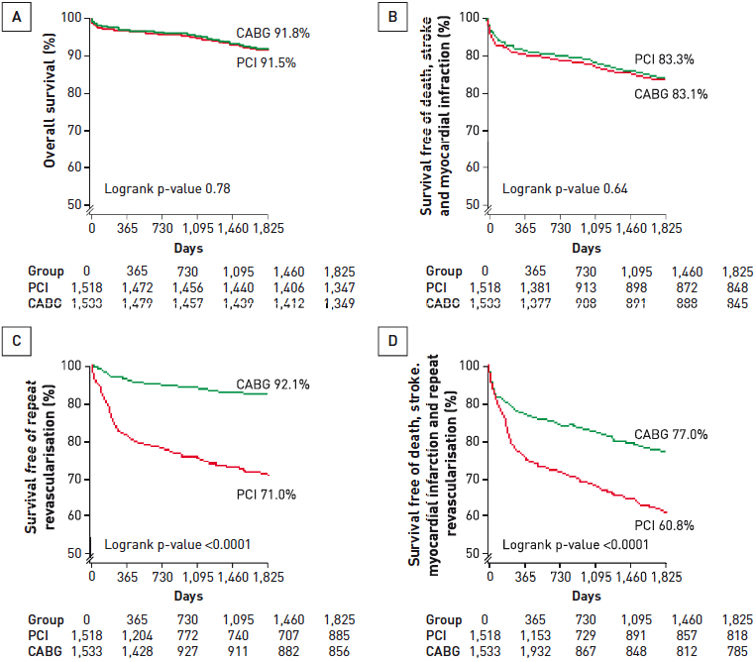

Interventions for stable coronary disease (chronic coronary syndromes)
Figure 12
Outcomes with multivessel PCI with bare metal stents compared to CABGData from a meta-analysis of 4 trials comparing PCI with bare metal stents to CABG in patients with multivessel CAD. Overall survival (A), survival free of death, stroke and myocardial infraction (B), survival free of repeat revascularisation (C) and survival free of death, stroke, myocardial infarcation and repeat revascularisation (D). 5-year death, MI, and stroke rates were similar with either revascularisation strategy, but patients who received PCI had significantly more repeat revascularisations than those who underwent CABG.[Adapted with permission from Daemen J et al. Circulation. 2008;118:1146-54]
Pradyumna Tummala, Bill D. Gogas, Patrick Bastos Metzger, David Williams, J. Ribamar Costa Jr, Raffaele piccolo
©2025 Europa Group - All rights reserved.

