Slide 1


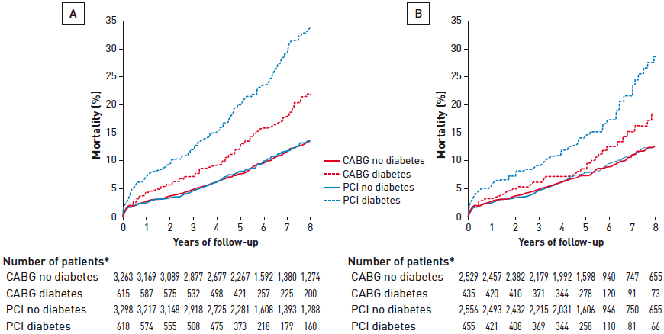

Interventions for stable coronary disease (chronic coronary syndromes)
Figure 13
Impact of diabetes and revascularisation strategy on survivalData from a meta-analysis of 10 trials [(A) 6 trials comparing PTCA to CABG; (B) 4 trials comparing PCI with bare metal stents to CABG] in patients with multivessel CAD. Survival was no different in patients treated with PCI compared to CABG in non-diabetic patients. However, diabetic patients had much better survival if they were randomised to CABG compared to PCI.[Adapted with permission from Hlatky MA et al. Lancet. 2009;373:1190-97]
Pradyumna Tummala, Bill D. Gogas, Patrick Bastos Metzger, David Williams, J. Ribamar Costa Jr, Raffaele piccolo
©2025 Europa Group - All rights reserved.

