Slide 1


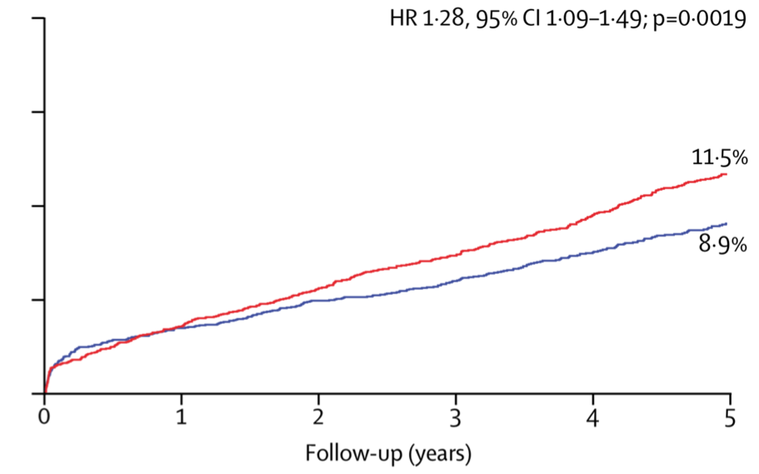

Interventions for stable coronary disease (chronic coronary syndromes)
Figure 14
Mortality after CABG vs. PCI during 5 years’ follow-up in patients with MVD
Pradyumna Tummala, Bill D. Gogas, Patrick Bastos Metzger, David Williams, J. Ribamar Costa Jr, Raffaele piccolo
©2025 Europa Group - All rights reserved.

