Slide 1


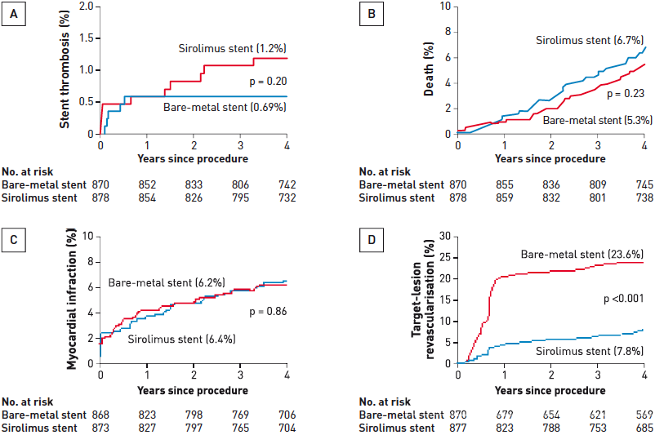

Interventions for stable coronary disease (chronic coronary syndromes)
Figure 16
Safety and efficacy of drug-eluting stents (DES)Meta-analysis of pooled randomised controlled trials comparing Cypher® sirolimus-eluting stents to bare metal stents (BMS). There was a nonsignificant trend towards higher very late stent thrombosis rates (A), occurring after 1 year, in patients who received DES compared to BMS. Death and MI rates are similar over 4 years (B and C), with a significant reduction in target lesion revascularisation rate with the use of sirolimus-eluting stents (D). Similar data has been shown for paclitaxel-eluting Taxus® stents.[Adapted with permission from Stone GW et al. N Engl J Med. 2007;356(10):998-1008]
Pradyumna Tummala, Bill D. Gogas, Patrick Bastos Metzger, David Williams, J. Ribamar Costa Jr, Raffaele piccolo
©2025 Europa Group - All rights reserved.

