Slide 1


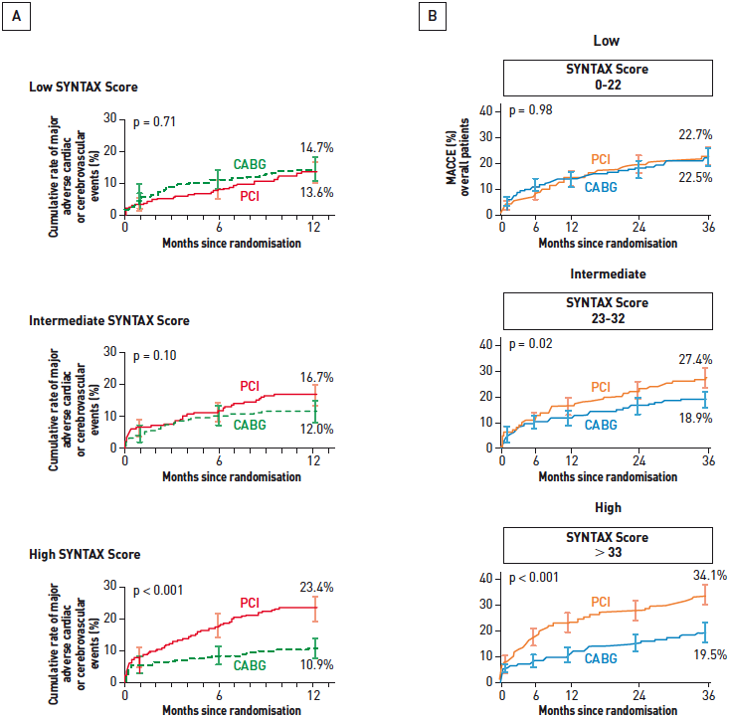

Interventions for stable coronary disease (chronic coronary syndromes)
Figure 21
One-year and three-year outcomes of the SYNTAX trial stratified by severity of disease (SYNTAX score)Patients who underwent PCI with Taxus DES had similar MACCE rates at (A) 1 and (B) 3 years compared to CABG if their SYNTAX score, a reflection of the anatomic burden of disease, was low (≤22). As SYNTAX score increases to intermediate to high, there is a clear separation of curves with considerably fewer MACCE rates in patients treated with CABG.[Adapted with permission from Serruys PW et al. N Engl J Med. 2009;360:961-72 and from Kappetein AP et al. Eur Heart J. 2011;32:2125-34]
Pradyumna Tummala, Bill D. Gogas, Patrick Bastos Metzger, David Williams, J. Ribamar Costa Jr, Raffaele piccolo
©2025 Europa Group - All rights reserved.

