Slide 1


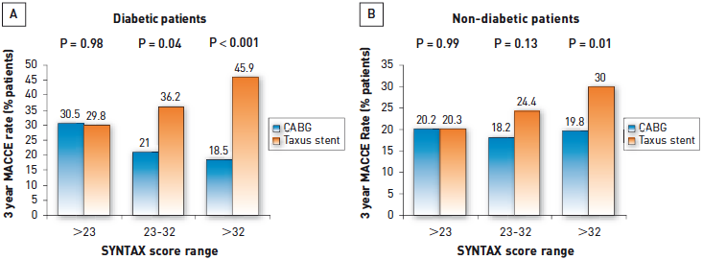

Interventions for stable coronary disease (chronic coronary syndromes)
Figure 22
3-year outcomes of patients in the SYNTAX trial: impact of diabetes and SYNTAX score3-year outcomes in the SYNTAX trial depending on SYNTAX score and presence of diabetes (A). The improvement of outcomes (MACCE rates) is particularly evident with greater burden of disease/higher SYNTAX scores especially in diabetic patients. Non-diabetic patients (B).[From data presented by Kappetein AP et al at the 2010 European Association for Cardio-Thoracic Surgery meeting]
Pradyumna Tummala, Bill D. Gogas, Patrick Bastos Metzger, David Williams, J. Ribamar Costa Jr, Raffaele piccolo
©2025 Europa Group - All rights reserved.

