Slide 1


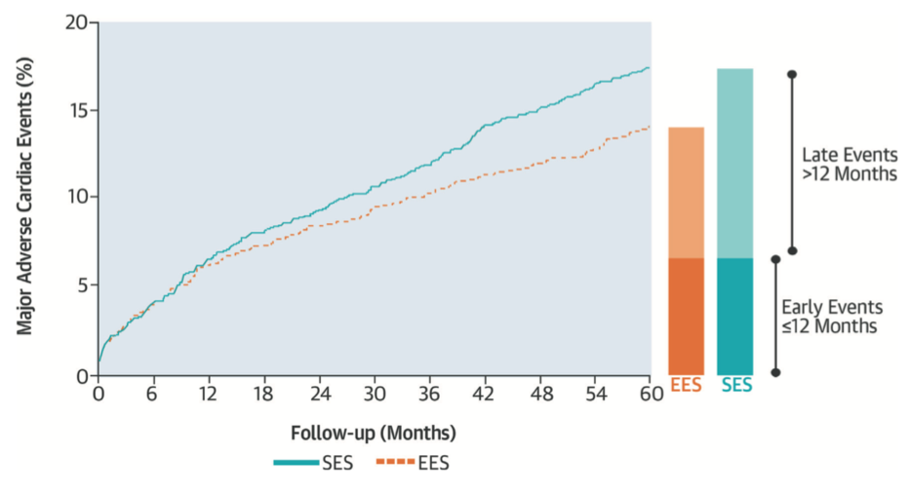

Interventions for stable coronary disease (chronic coronary syndromes)
Figure 23
The overall rate of composite MACE at 5 years in the EES group and the SES group
Pradyumna Tummala, Bill D. Gogas, Patrick Bastos Metzger, David Williams, J. Ribamar Costa Jr, Raffaele piccolo
©2025 Europa Group - All rights reserved.

