Slide 1


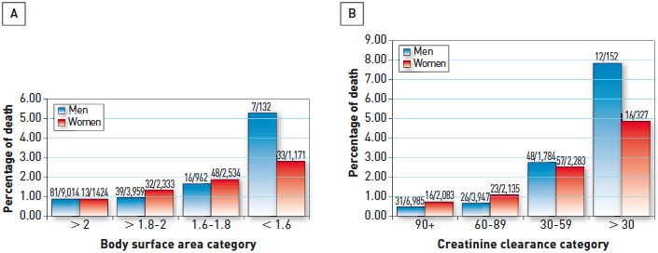

Interventions for stable coronary disease (chronic coronary syndromes)
Figure 27
Outcomes after PCI are similar in men and women after adjustment for comorbid conditionsIn a registry of 22,725 consecutive patients who underwent PCI between 2002 and 2003, female gender was associated with older age and higher in-hosptial death, vascular complications, blood transfusion, stroke, and MACE (A). However, after adjustment for renal function and low body surface area (B), there were no longer any significant gender-related differences in outcomes.[Adapted with permission from Duvernoy CS et al. Am Heart J. 2010;159:677-83]
Pradyumna Tummala, Bill D. Gogas, Patrick Bastos Metzger, David Williams, J. Ribamar Costa Jr, Raffaele piccolo
©2025 Europa Group - All rights reserved.

