Slide 1


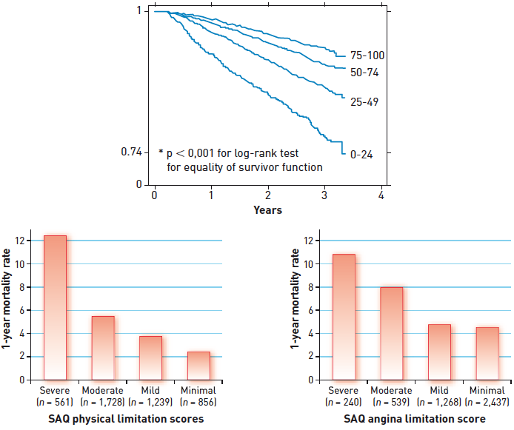

Interventions for stable coronary disease (chronic coronary syndromes)
Figure 3
Predictive value of severity of angina pectorisPatients who had less limiting angina had improved survival compared to those with more severe angina.[Adapted with permission from Mozaffarian D et al. Am Heart J. 2003;146:1015-22 and Spertus JA et al. Circulation. 2002;106:43-49]
Pradyumna Tummala, Bill D. Gogas, Patrick Bastos Metzger, David Williams, J. Ribamar Costa Jr, Raffaele piccolo
©2025 Europa Group - All rights reserved.

