Slide 1


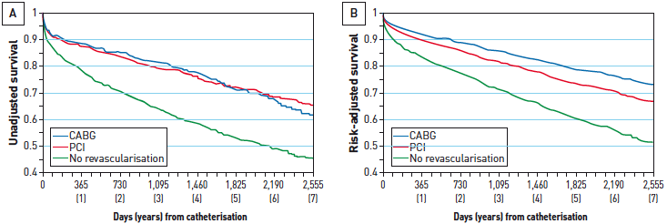

Interventions for stable coronary disease (chronic coronary syndromes)
Figure 30
Benefit of revascularisation in patients with CAD and heart failureThe APPROACH investigators followed 2,538 patients with CAD in the setting of heart failure. Survival curves up to 7 years are shown [(A) unadjusted survival; (B) risk-adjusted survival], demonstrating significantly better survival with revascularisation with PCI or CABG compared to those patients who received medical therapy alone. [Adapted with permission from Tsuyuki RS et al. CMAJ. 2006;175:361-5]
Pradyumna Tummala, Bill D. Gogas, Patrick Bastos Metzger, David Williams, J. Ribamar Costa Jr, Raffaele piccolo
©2025 Europa Group - All rights reserved.

