Slide 1


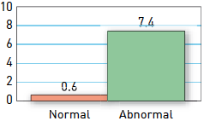

Interventions for stable coronary disease (chronic coronary syndromes)
Figure 4
Ischaemia and cardiac events in patients with stable symptoms of CAD. Analysis of 14 studies involving >12,000 patientsRate of major cardiac events (death or non-fatal MI) in patients with normal and abnormal stress SPECT images. Patients with abnormal stress SPECT images have markedly worse annual cardiovascular event rates compared to those who have normal scans.[Adapted with permission from Iskander S and Iskandrian AE. J Am Coll Cardiol.1998;32:57-62]
Pradyumna Tummala, Bill D. Gogas, Patrick Bastos Metzger, David Williams, J. Ribamar Costa Jr, Raffaele piccolo
©2025 Europa Group - All rights reserved.

