Slide 1


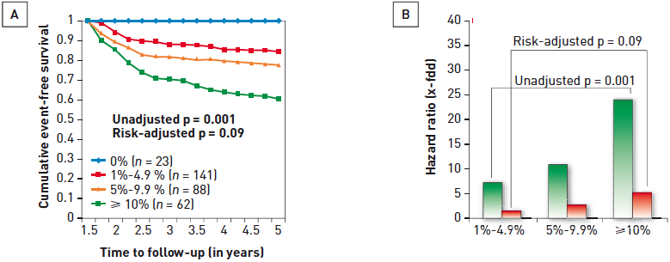

Interventions for stable coronary disease (chronic coronary syndromes)
Figure 5
Nuclear substudy data from the COURAGE trial(A) 5-year survival free of death or MI was inversely proportional to the percentage of left ventricular myocardium which had ischaemia, measured after 6 to 18 months follow-up. (B) Unadjusted (green bars) and adjusted (orange bars) representing hazard ratios for the extent of residual ischaemia at 6 to 18 months of follow-up. [Adapted with permission from Shaw LJ et al. Circulation. 2008;117:1283-91]
Pradyumna Tummala, Bill D. Gogas, Patrick Bastos Metzger, David Williams, J. Ribamar Costa Jr, Raffaele piccolo
©2025 Europa Group - All rights reserved.

