Slide 1


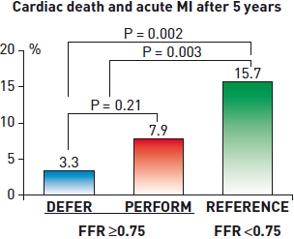

Interventions for stable coronary disease (chronic coronary syndromes)
Figure 6
DEFER Study: cardiac death and MI after 5 yearsPatients with single vessel CAD who had FFR ≥0.75 in the treated vessel demonstrated a nonsignificant trend of having greater cardiac death and MI if they received PCI (Perform group) rather than medical therapy without revascularisation (Defer group). The Reference group consisted of patients with single vessel CAD who had FFR
Pradyumna Tummala, Bill D. Gogas, Patrick Bastos Metzger, David Williams, J. Ribamar Costa Jr, Raffaele piccolo
©2025 Europa Group - All rights reserved.

