Slide 1


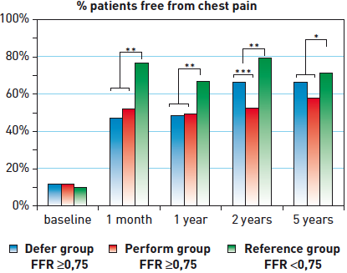

Interventions for stable coronary disease (chronic coronary syndromes)
Figure 7
DEFER Study: angina controlPatients in the Defer and Perform groups had similar survival free of chest pain at most time points. Patients with the most severe disease (FFR
Pradyumna Tummala, Bill D. Gogas, Patrick Bastos Metzger, David Williams, J. Ribamar Costa Jr, Raffaele piccolo
©2025 Europa Group - All rights reserved.

