Slide 1


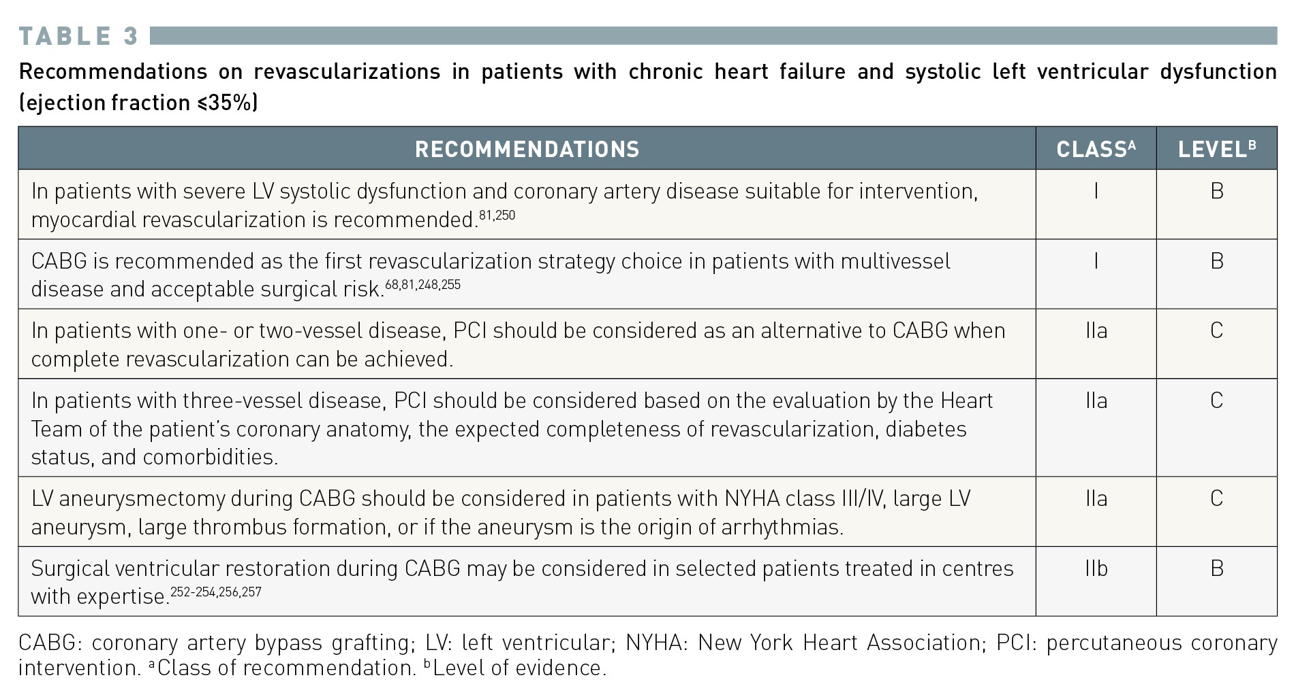
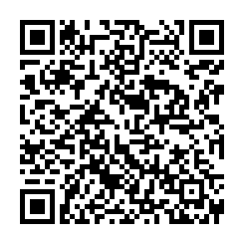
Interventions for stable coronary disease (chronic coronary syndromes)
Table 3
Recommendations for patients with chronic heart failure and systolic LV dysfunction (EF ≤35%), presenting predominantly with heart failure symptoms and no, or mild, anginal symptoms (Canadian Cardiovascular Society Class 1 or 2) 2018 ESC/EACTS Guidelines on myocardial revascularization The Task Force on myocardial revascularization of the European Society of Cardiology (ESC) and European Association for Cardio-Thoracic Surgery (EACTS)
Pradyumna Tummala, Bill D. Gogas, Patrick Bastos Metzger, David Williams, J. Ribamar Costa Jr, Raffaele piccolo
©2025 Europa Group - All rights reserved.

