Slide 1


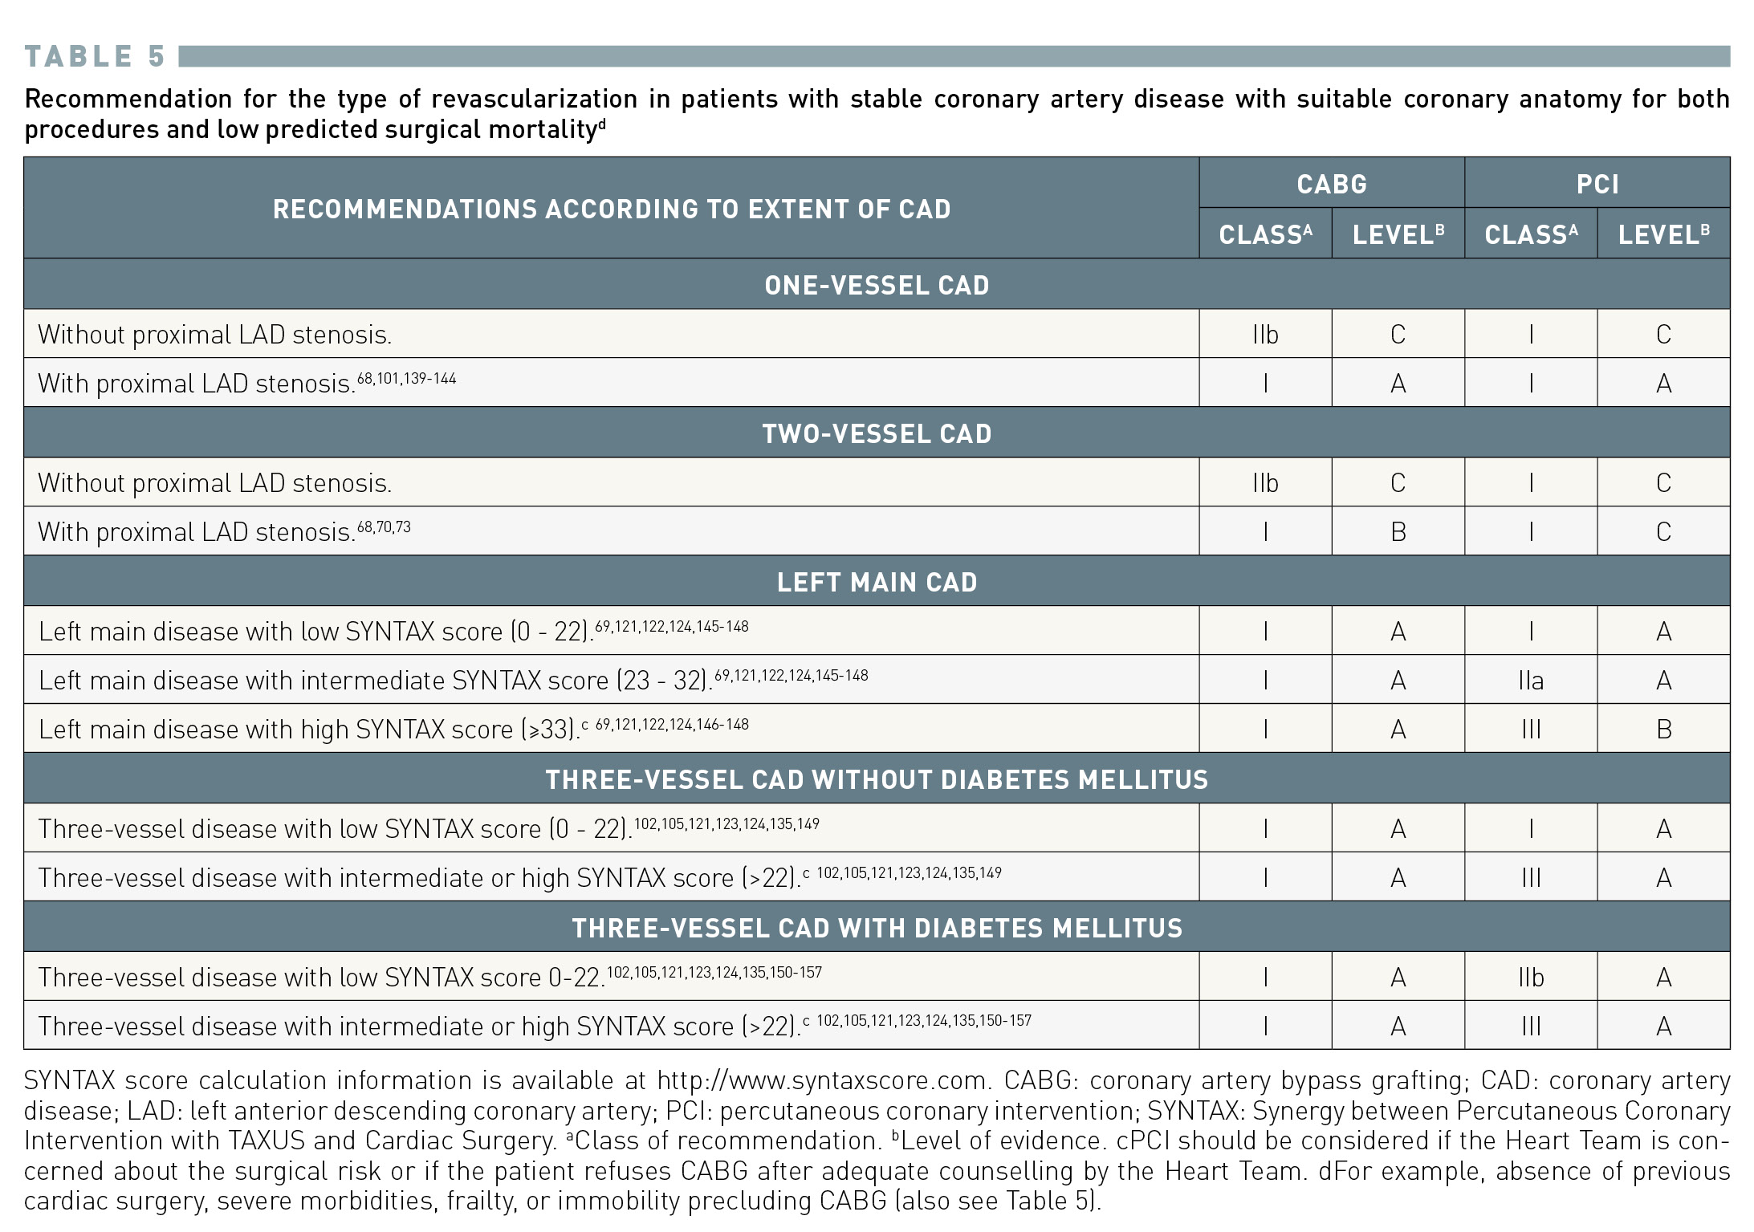
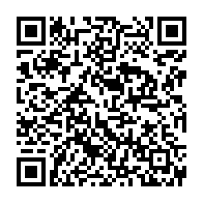
Interventions for stable coronary disease (chronic coronary syndromes)
Table 5
Indications for coronary artery bypass grafting vs. percutaneous coronary intervention in stable patients with lesions suitable for both procedures and low predicted surgical mortality 2018 ESC/EACTS Guidelines on myocardial revascularization The Task Force on myocardial revascularization of the European Society of Cardiology (ESC) and European Association for Cardio-Thoracic Surgery (EACTS)
Pradyumna Tummala, Bill D. Gogas, Patrick Bastos Metzger, David Williams, J. Ribamar Costa Jr, Raffaele piccolo
©2025 Europa Group - All rights reserved.

