Slide 1


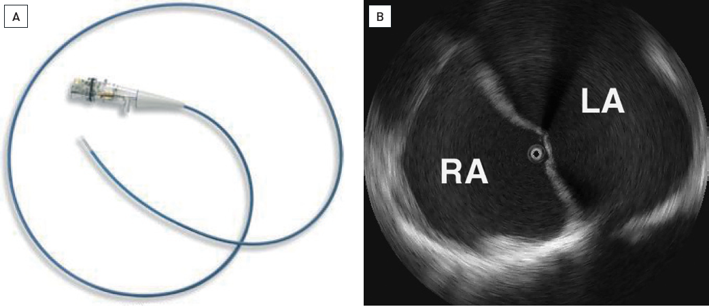

Intracardiac echocardiography
Figure 1
Intercardiac mechanical Ultrasound system(A) Ultra ICE™ Catheter (Boston Scientific Co., Natick, MA, USA) [16]. The catheter consists of a rotational drive shaft powering a 9 MHz transducer located at the tip. The piezoelectric crystal rotates through the sector at a high sweep speed to generate the image. The catheter is inserted over-the-wire through precurved Convoy™ introducer sheaths that are bent at 15-160° curves. One sheath may be exchanged for another if a different view is needed. (B) View with the Ultra ICE™ Catheter placed in the right atrium. Right atrium (RA), left atrium (LA).[(A) Image provided courtesy of Boston Scientific. © 2011 Boston Scientific Corporation or its affiliates. All rights reserved. (B) From reference 16, Figure 3.3 page 21. Reprinted with permission from Taylor & Francis]
Anna Bortnick, Rim Halaby, Frank E. Silvestry, Howard C. Herrmann
©2025 Europa Group - All rights reserved.

