Slide 1


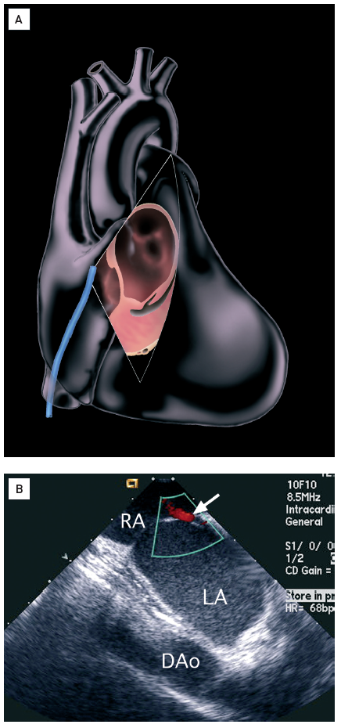

Intracardiac echocardiography
Figure 10
90-100° interatrial septal long-axis view(A) 90-100° with posterior and rightward deflection constitutes the “interatrial septal long-axis view”. The septum secundum and fossa ovalis are well seen in this position, which is ideal for atrial septal defect (ASD) and patent foramen ovale (PFO) closure [16]. Image created by artist Starr Kaplan. (B) Colour Doppler of a patent foramen ovale. Right atrium (RA), left atrium (LA), Descending aorta (DA°).[Reprinted with permission from Taylor & Francis. From reference 16, Figure 5.13D, page 64]
Anna Bortnick, Rim Halaby, Frank E. Silvestry, Howard C. Herrmann
©2025 Europa Group - All rights reserved.

