Slide 1


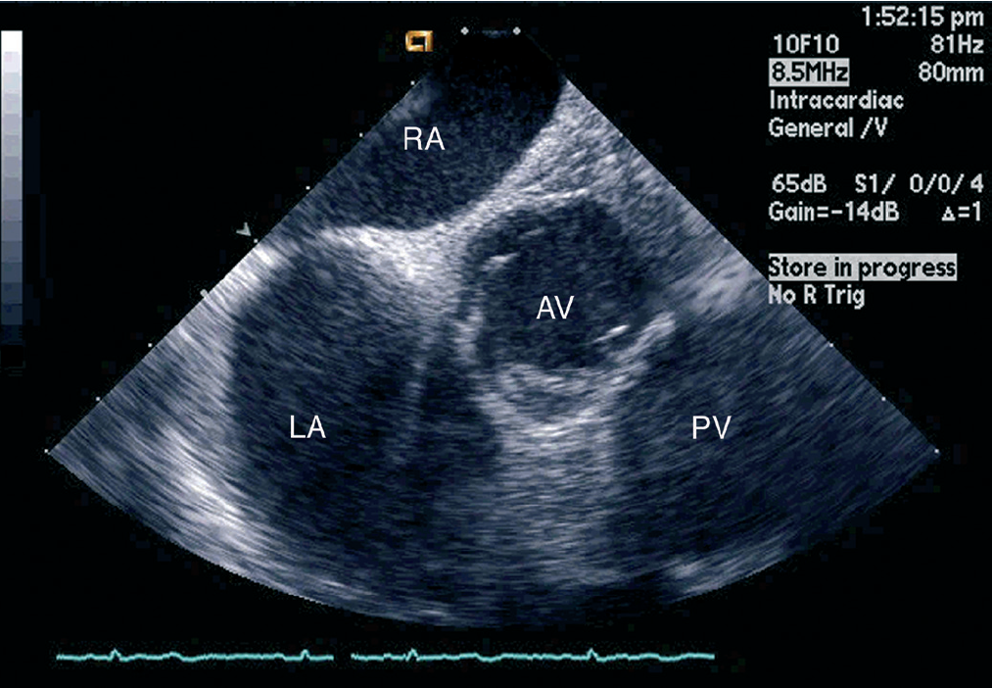

Intracardiac echocardiography
Figure 11
90-100° with posterior and rightward deflection and a small amount of clockwise rotation results in the “aortic” or “septal short axis view” [16]Right atrium (RA), left atrium (LA), aortic valve (AV), pulmonic valve (PV).[Reprinted with permission from Taylor & Francis. From reference 16, Figure 5.14A, page 65]
Anna Bortnick, Rim Halaby, Frank E. Silvestry, Howard C. Herrmann
©2025 Europa Group - All rights reserved.

