Slide 1


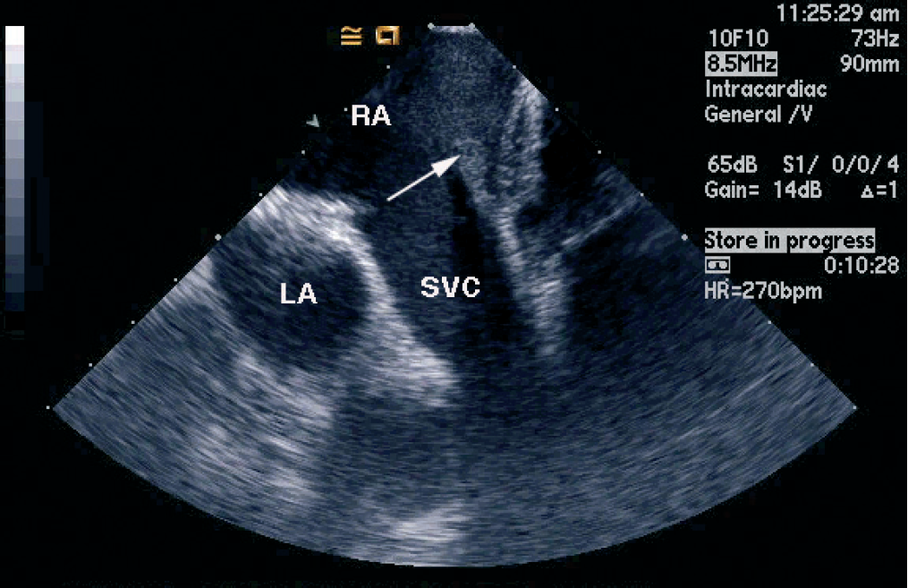

Intracardiac echocardiography
Figure 12
210-240° (“superior vena cava view”) from the neutral position and mild posterior deflectionThis view is analogous to the bicaval view on transoesophageal echocardiography which is excellent for imaging the interatrial septum [16]. Right atrium (RA), left atrium (LA), superior vena cava (SVC). The arrow points to the crista terminalis.[Reprinted with permission from Taylor & Francis. From reference 16, Figure 5.17A, page 67]
Anna Bortnick, Rim Halaby, Frank E. Silvestry, Howard C. Herrmann
©2025 Europa Group - All rights reserved.

