Slide 1


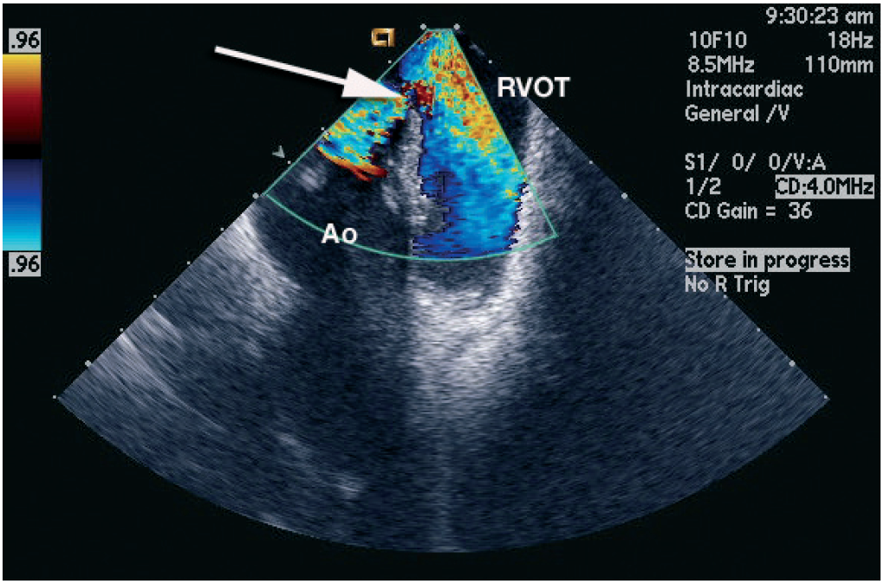

Intracardiac echocardiography
Figure 15
View from the right ventricular outflow tract of a membranous ventricular septal defect (VSD) [16]Right ventricular outflow tract (RVOT), aorta (Ao). The arrow points to the VSD.[Reprinted with permission from Taylor & Francis. From reference 16, Figure 5.21B, page 71.]
Anna Bortnick, Rim Halaby, Frank E. Silvestry, Howard C. Herrmann
©2025 Europa Group - All rights reserved.

