Slide 1


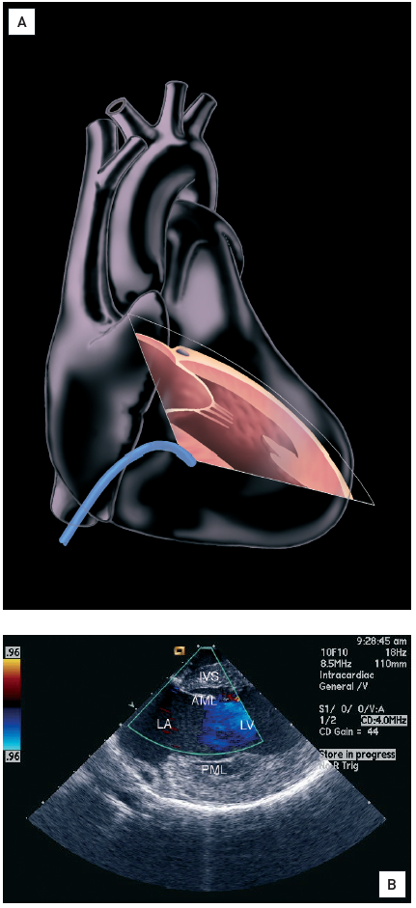

Intracardiac echocardiography
Figure 16
View from the right ventricle with rightward deflection of the catheter.(A) View from the right ventricle with rightward deflection of the catheter. (B) An oblique long axis view of the left atrium, mitral valve, and left ventricle are seen with the interventricular septum at the top of the image. Colour Doppler flow across the mitral valve is shown [14].LA: left atrium; LV: left ventricle; IVS: interventricular septum; AML: anterior mitral leaflet; PML: posterior mitral leaftlet. Effusion: Moving image 17.
Anna Bortnick, Rim Halaby, Frank E. Silvestry, Howard C. Herrmann
©2025 Europa Group - All rights reserved.

