Slide 1


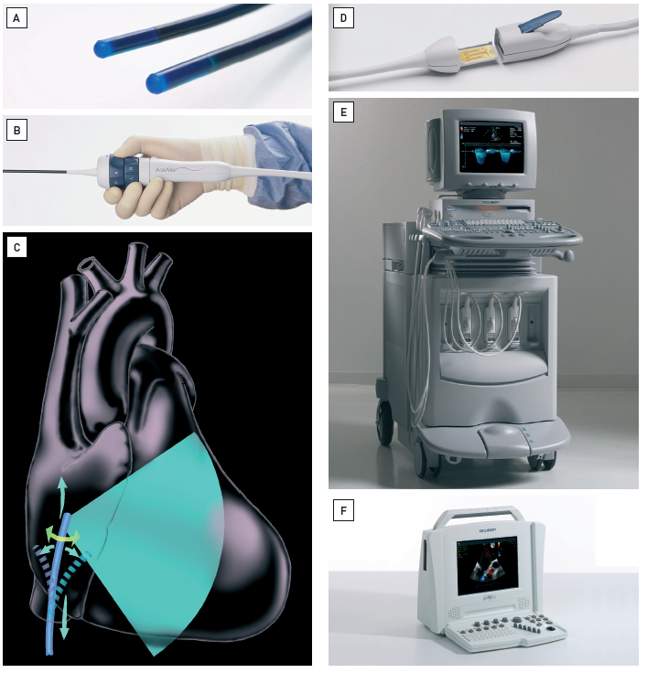

Intracardiac echocardiography
Figure 2
Intercardiac phased array ultrasound catheter system(A) Acuson AcuNav™ Diagnostic Ultrasound catheter (Siemens, Mountain View, CA, USA) [16]. AcuNav™ catheters can be axially and laterally rotated and the tips deflected anteriorly/posteriorly, up to 160°. The system is a miniaturised form of the traditional, hand-held ultrasound probe. Reprinted from reference 16, Figure 3.6A, page 23. (B) The user manipulates the catheter position by changing its orientation with knobs on the handle of the cather. P (posterior), A (anterior), R (right), L (left). Reprinted from reference 16, Figure 3.6B, page 23. (C) Phased array systems have broader capabilities than mechanical transducers which generate the familiar, 2D wedge-shaped, longitudinal axis image seen on transthoracic or transoesophageal echo [16]. The imaging sector is 90° to the tip of the transducer. Image created by artist Starr Kaplan. (D) The handle of the probe attaches to various consoles via the reusable SwiftLink™ connector (Siemens, Mountain View, CA, USA). (E) The AcuNav™ can be connected to the Acuson Sequoia™, a traditional 2D echocardiography system, a common instrument in most echocardiography labs. (F) The AcuNav™ also connects to the portable Cypress™ ultrasound machine (Siemens, Mountain View, CA, USA). [Images courtesy of Siemens Medical Solutions]
Anna Bortnick, Rim Halaby, Frank E. Silvestry, Howard C. Herrmann
©2025 Europa Group - All rights reserved.

