Slide 1


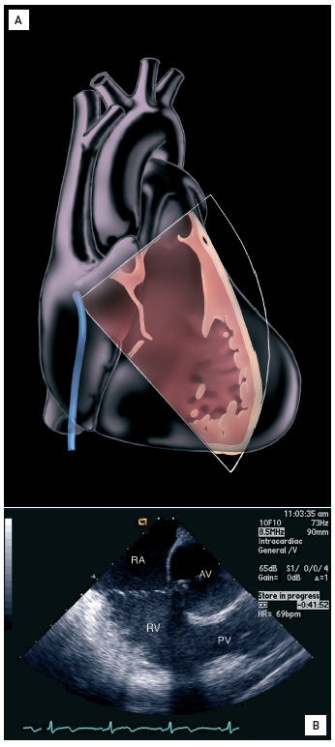

Intracardiac echocardiography
Figure 5
Right ventricular outflow tract view(A) 30-40° (“right ventricular outflow tract (RVOT) view”). Clockwise rotation points the tip of the transducer posteriorly. Image created by artist Starr Kaplan. (B) The RVOT and pulmonic valve are brought into view [16].[Reprinted with permission from Taylor & Francis. From reference 16, Figure 5.6B, page 59]
Anna Bortnick, Rim Halaby, Frank E. Silvestry, Howard C. Herrmann
©2025 Europa Group - All rights reserved.

