Slide 1


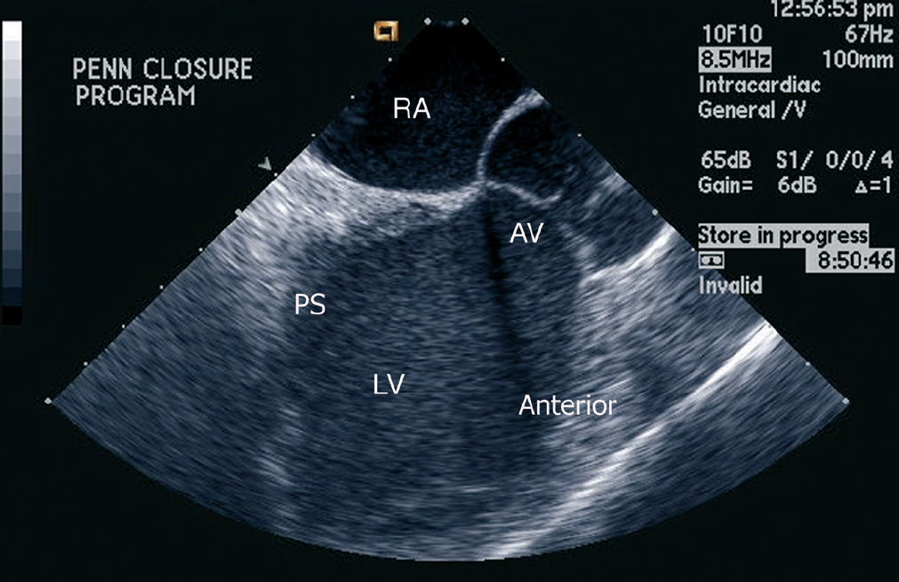

Intracardiac echocardiography
Figure 6
45° (“left ventricular outflow tract (LVOT) view”)This view shows an oblique long axis view of the left ventricle. The anteriorand inferior walls of the left ventricle are seen, in addition to the LVOT, and long axis view of the aortic valve. This view is best for Doppler interrogation of the aortic valve [16]. Right atrium (RA), aortic valve (AV), left ventricle (LV), anterior wall (Anterior), posterior septum (PS).[Reprinted with permission from Taylor & Francis. From reference 16, Figure 5.7, page 60]
Anna Bortnick, Rim Halaby, Frank E. Silvestry, Howard C. Herrmann
©2025 Europa Group - All rights reserved.

