Slide 1


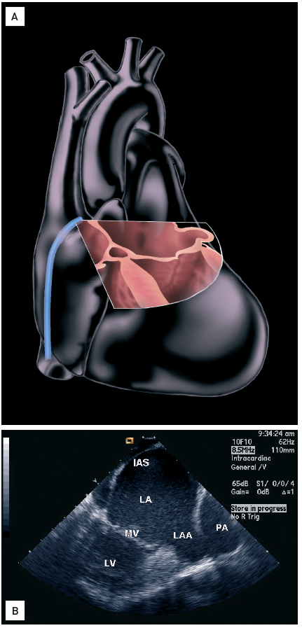

Intracardiac echocardiography
Figure 7
60-70° Left atrial appendage view(A) Higher up in the right atrium and clockwise rotating to 60-70° (“left atrial appendage view” or “lower interatrial septal view”). The lower interatrial septum, left atrium, left atrial appendage, and mitral valve are well seen. Colour Doppler interrogation of the mitral valve is best in this view. Image created by artist Starr Kaplan. (B) A four-chamber view can be obtained from this position by tilting the catheter to the right [16]. Interatrial septum (IAS), left atrium (LA), mitral valve (MV), left ventricle (LV), left atrial appendage (LAA), pulmonary artery (PA).[Reprinted with permission from Taylor & Francis. From reference 16, Figure 5.9B, page 60]
Anna Bortnick, Rim Halaby, Frank E. Silvestry, Howard C. Herrmann
©2025 Europa Group - All rights reserved.

