Slide 1


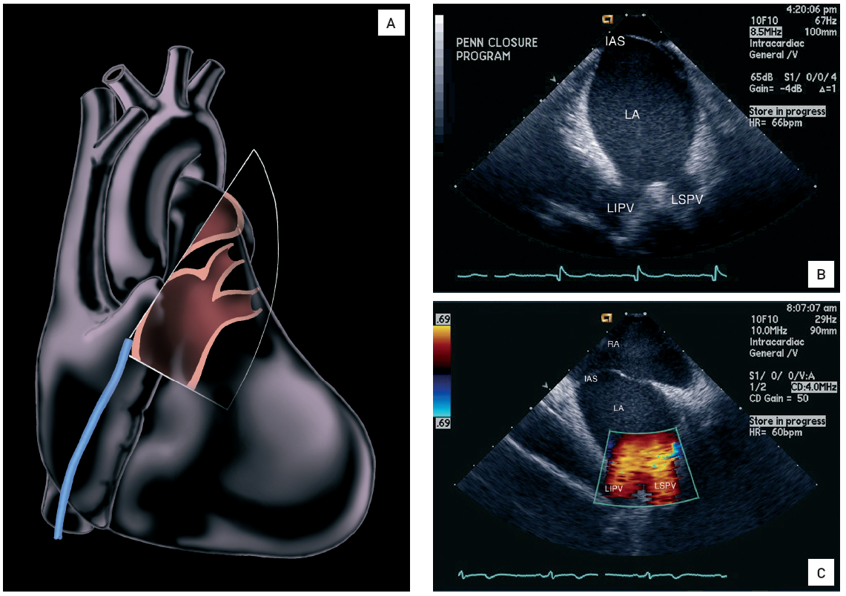

Intracardiac echocardiography
Figure 9
Clockwise rotation high in the right atrium to 90-100° (“left pulmonary veins view”)(A-B) This view reveals a long axis view of the left inferior and left superior pulmonary veins and is used for pulmonary vein isolation in the treatment of atrial fibrillation [16]. Image A created by artist Starr Kaplan. Figure B reprinted from reference 16, original figure 5.12B, page 63. (C) Colour Doppler of the left pulmonary veins. Interatrial septum (IAS), left atrium (LA), left inferior pulmonary vein (LIPV), left superior pulmonary vein (LSPV).[Reprinted with permission from Taylor & Francis. From reference 16, Figure 5.12C, page 63]
Anna Bortnick, Rim Halaby, Frank E. Silvestry, Howard C. Herrmann
©2025 Europa Group - All rights reserved.

