Slide 1


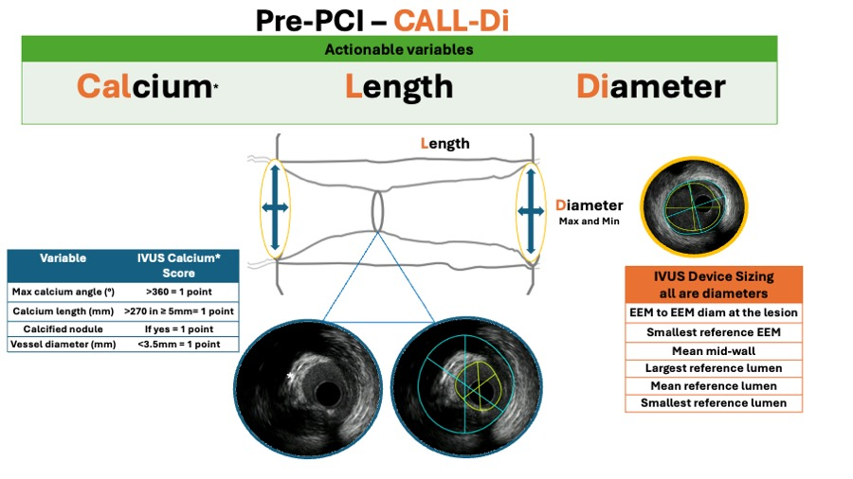

Intravascular ultrasound
Figure 10A
IVUS helps to guide the PCI following a systematic approach. In the pre-PCI phase (figure 10A), the CALL-Di workflow should be executed to ensure that no relevant and actional information is overlooked.
Hector M. García-García, Fernando Alfonso
©2025 Europa Group - All rights reserved.

