Slide 1


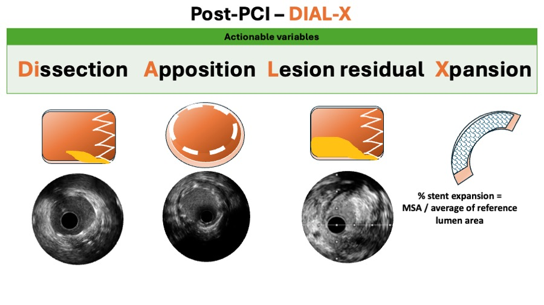

Intravascular ultrasound
Figure 10B
Similarly, in the post PCI phase (figure 10B), the DIAL-X workflow should be followed.
Hector M. García-García, Fernando Alfonso
©2025 Europa Group - All rights reserved.

