Slide 1


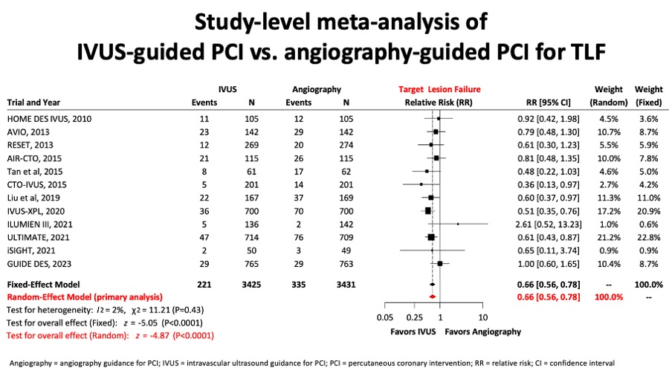

Intravascular ultrasound
Figure 11A
A network metanalysis reported for the comparision between IVUS- and angio-guided PCI, the target lesion failure (figure 11A) composite endpoint was significantly reduced.
Hector M. García-García, Fernando Alfonso
©2025 Europa Group - All rights reserved.

