Slide 1


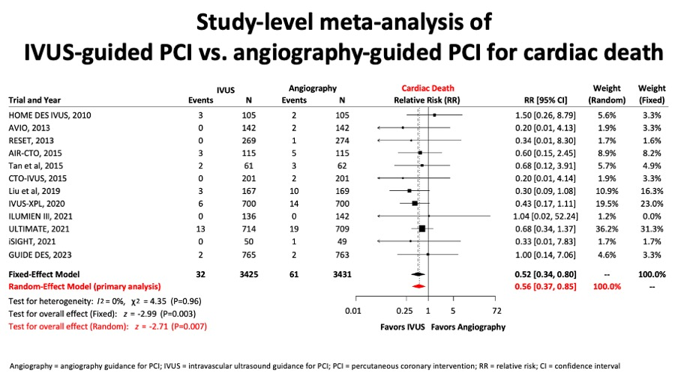

Intravascular ultrasound
Figure 11B
Similarly, in figure 11B, a important reduction in cardiac death in the group of IVUS-guided PCI was observed.
Hector M. García-García, Fernando Alfonso
©2025 Europa Group - All rights reserved.

