Slide 1


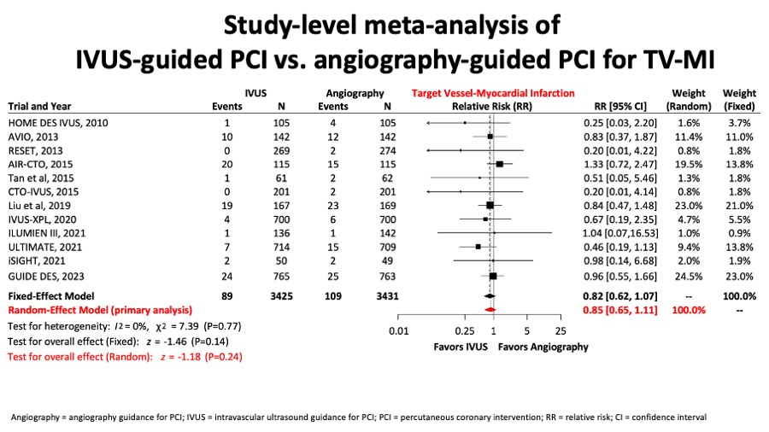

Intravascular ultrasound
Figure 11C
There was no difference in terms of target vessel myocardial infarction (figure 11C).
Hector M. García-García, Fernando Alfonso
©2025 Europa Group - All rights reserved.

