Slide 1


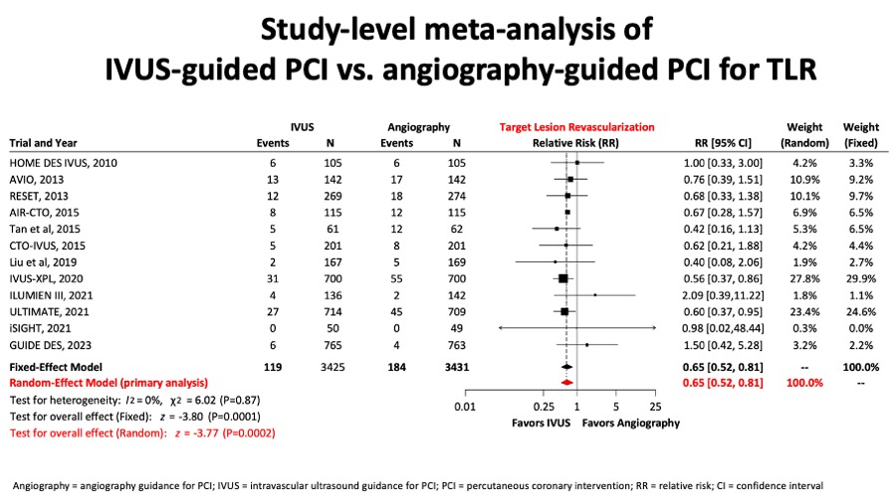

Intravascular ultrasound
Figure 11D
Conversely, there was a clinically relevant and significant reduction of target lesion revascularisation rates in the IVUS-guided PCI group (figure 11D).
Hector M. García-García, Fernando Alfonso
©2025 Europa Group - All rights reserved.

