Slide 1

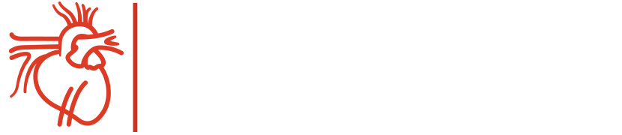
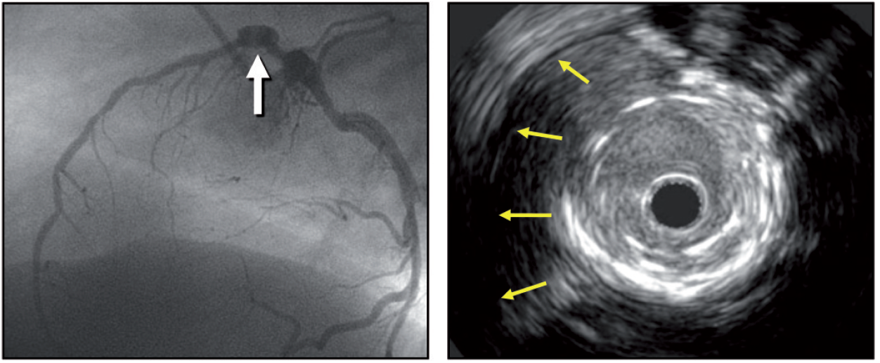
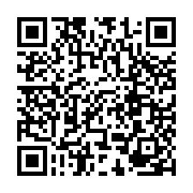
Intravascular ultrasound
Figure 12
A coronary aneurysm is seen in the proximal segment of the left anterior descending by angiography and on IVUS, the yellow arrows show the separation of the vessel wall from the stent.
Hector M. García-García, Fernando Alfonso
©2025 Europa Group - All rights reserved.

