Slide 1


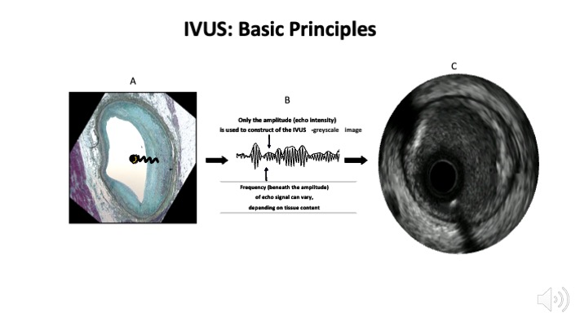

Intravascular ultrasound
Figure 2
Intravascular ultrasound basic principles. Panel A shows how an intravascular ultrasound signal is obtained from the vessel wall within an histology image. The signal is formed by the envelope (amplitude) of the radiofrequency data, which is illustrated in panel B. The greyscale IVUS image, as can be appreciated in panel C, is the end result.
Hector M. García-García, Fernando Alfonso
©2025 Europa Group - All rights reserved.

