Slide 1


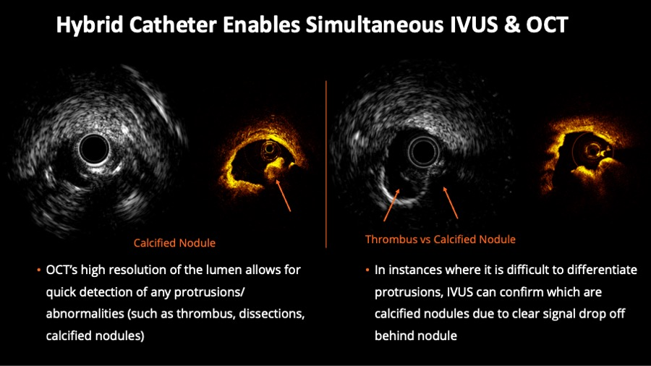

Intravascular ultrasound
Figure 3
Hybrid Catheter Enables Simultaneous intravascular ultrasound (IVUS) & optical coherence tomography (OCT). On the left half of the figure, corresponding IVUS and OCT frames help to evaluate luminal protrusions. On the right side of the figure, the example shows the value of concomitant evaluation for the desambiguation of thrombus versus calcified nodule.
Hector M. García-García, Fernando Alfonso
©2025 Europa Group - All rights reserved.

